Slide 1
Children’s voices must be heard in matters that affect them “I am not invisible”

Slide 2
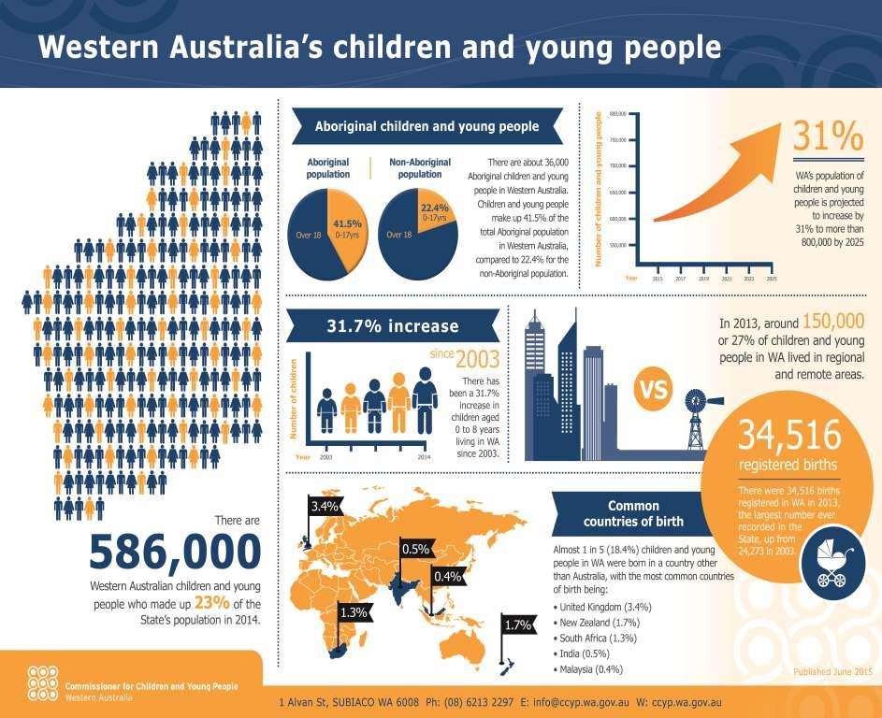

Slide 3
CCYP Act – Four guiding principles
Children and young people are entitled to live in a caring and nurturing environment and to be protected from harm and exploitation
The contributions made by children and young people to the community should be recognised for their value and merit
The views of children and young people on all matters affecting them should be given serious consideration and taken into account
Parents, families and communities have the primary role in safeguarding and promoting the wellbeing of their children and young people and should be supported in carrying out their role.

Slide 4
CCYP Act – Functions
To promote the participation of children and young people in the making of decisions that affect their lives and to encourage government and non-government agencies to seek the participation of children and young people appropriate to their age and maturity
To initiate or conduct inquiries into any matter, including any written law or any practice, procedure or service, affecting the wellbeing of children and young people.

Slide 5
UN Convention on the Rights of the Child
Article 9: Children should not be separated from their parents unless it is for their own good. Children whose parents have separated have the right to stay in contact with both parents, unless this might harm the child
Article 12: Children have the right to say what they think should happen when adults are making decisions that affect them and have their opinions taken into account.

Slide 6
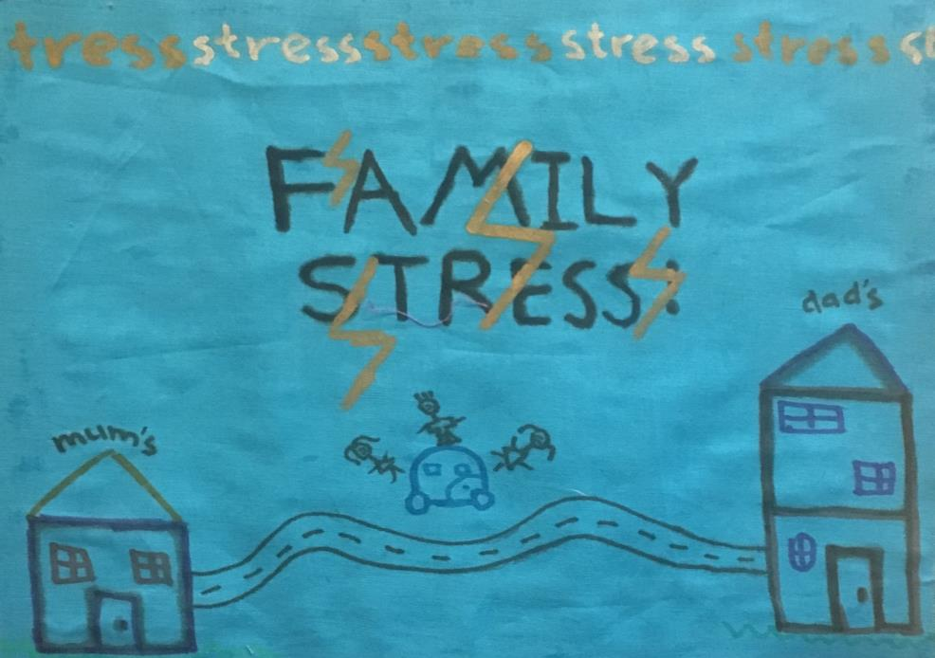

Slide 7
“Good parents are what every kid needs.”
boy, aged 16
“A lot of your friends get down because their families are having issues.”
girl aged 15

Slide 8
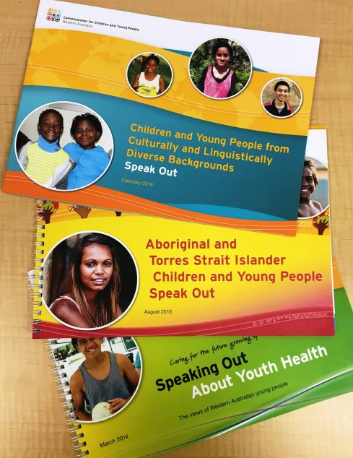
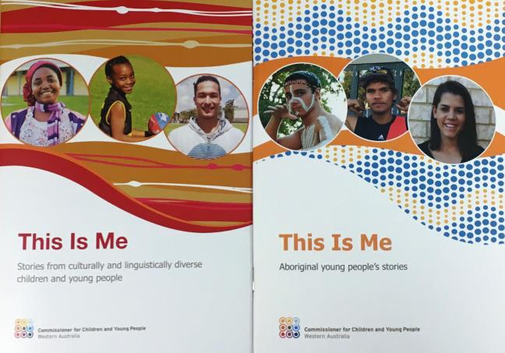

Slide 9
“Just listen to us.”
girl aged 10
“The children here are exposed to things that they should not be, such as drugs and alcohol, family abuse… they need places where they can go and feel wanted and needed.” 17 year old

Slide 10
“My culture means everything to me, my family and my elders.” boy aged 10
“If you don’t have a family you can’t live.” boy aged 8

Slide 11
“I used to have these weird thoughts about how there was a machine that could scrub you to the point you were lighter… I just didn’t think it was normal to be dark… TV shows and everything like everyone was white or white skinned, it just didn’t make sense.” girl aged 13

Slide 12
“Instead of people just supporting you they should really understand you.” boy aged 17
“Thank you. Not many people ask us what we think.” girl aged 17

Slide 13
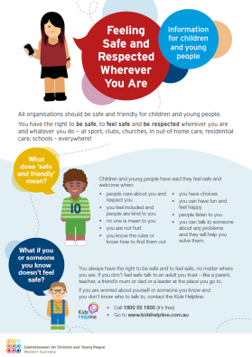

Slide 14
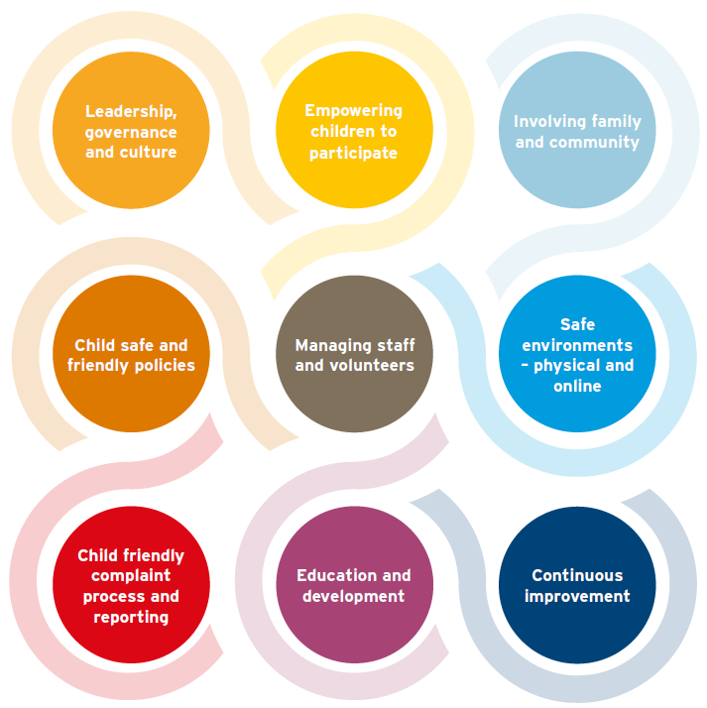
Nine domains of child safe organisations

Slide 15
“My parents separated when I was a toddler and were both actively involved in the Family Court until Dec 5, 2011.
It ended only because I lost my sisters and my mother.
Throughout this period of my life, from 2001 when I was 3 years old to 2011 when I was a 13 year-old I was interviewed by more social workers, counsellors, and psychologists/psychiatrists than I can recall, had consistent contact (and sometimes no contact) with my father and was placed in the care of my mother who loved me greatly but could never separate herself from the Family and SC cases.”
Extract of Statement by Grace Cuzen to West Australian Coroner

Slide 16
“The social workers, counsellors and all the other people I was forced to see never felt right either. I didn't trust them. They were strangers to me who interviewed me for a few hours at the most, almost never more than once, believing that this was enough to get an accurate honest and in depth assessment of me and my sisters, and our home life.
It begs the question how many children in my situation stuck in the Family Court, would talk honestly to a complete stranger about something they believed would get their mother, who they loved, into trouble.”
Extract of Statement by Grace Cuzen to West Australian Coroner

Slide 17
Mental health recommendations
12 recommendations that fall under:
-Resourcing and planning priorities
-Investment in younger children
-Prevention and early intervention
-Parenting information and support
-Strengthening the capacity of schools
-Vulnerable children and young people

Slide 18
“I reckon some kids I know don’t like going home because of the family problems there … that’s why they enjoy school is because they get away … there’s bad situations like families separate and things like that.” 15 year-old boy

Slide 19
“It is better when an adult you know and trust asks you for your feedback/thoughts rather than a random person because you may be shamed to say some things.”

Slide 21
“I did do counselling .. But most of the time I would be playing with the toys and instead of talking at the counsellor… I had opportunities to talk about it but I just didn’t do it.”
[what do you think stopped you?] “The fact of not knowing what would happen after.” 13 year-old boy

Slide 22
What children tell us makes a difference
Having friendly and engaged staff who like children
Being proactively asked their views
Having their views taken seriously
Being given choice and having flexibility around participating
Having information about expectations and clear rules of behaviour, and
Seeing action taken to stop problems from continuing
Doing what you say you will do.

Slide 24
“Listen to what young people have to say, and if you promise you are going to do something, do it, otherwise their trust in adults diminishes.”

Slide 25
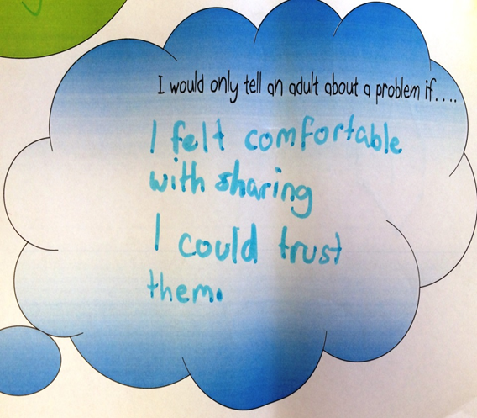

Slide 26
“…someone who bothered to listen, someone who wanted to help me out or make me feel like I was, you know, not just some other, like, criminal.”
18 year-old boy

Slide 28
“Sometimes kids they get scared.
A lot of people growing up with family violence when they get older they just think its normal because they’ve seen that all their life … they think that’s normal. I know that got me stuffed up.” 18 year-old male

Slide 29
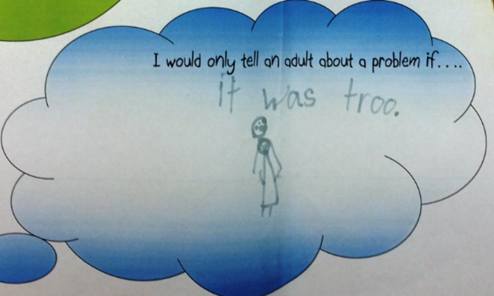

Slide 30
“…good people just know how to get on the kids’ level, help them…but don’t pretend that you’re trying to get along with them, just do get along with them, you know? You don’t pretend it. [It’s] just respect.”
17 year-old boy

Slide 31
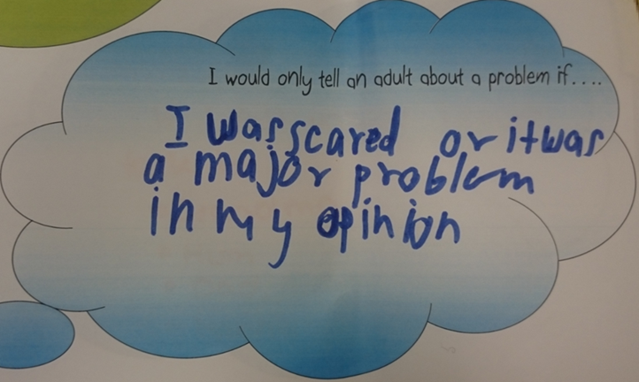
Notes:
Participation guidelines, page 10 and 13

Slide 32
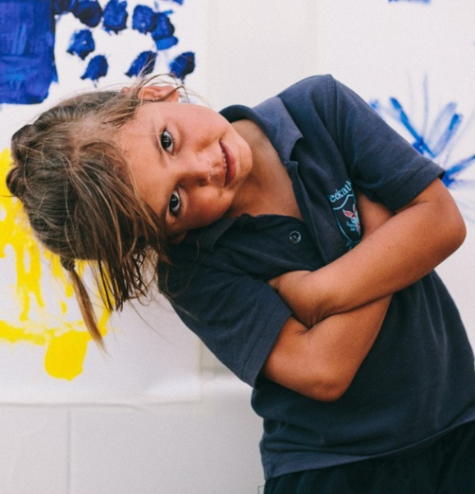
“So maybe you need to ask kids a lot of questions so that you know them.”
17 year-old girl

Slide 33
“So we can get other kids to speak up as well, not just a little bit of the kids, not just like ten or eleven. We want more kids to start speaking up so you can solve problems.” 11 year-old girl

Slide 35
Keep in touch:
@CCYPWA
New website www.ccyp.wa.gov.au
Phone 6213 2297

