Slide 1




Family violence – changes to WA tenancy laws
Presented by
Consumer Protection Senior Policy Officer
Trish Blake
15 February 2019 for:

Slide 2



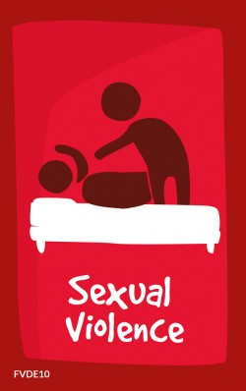



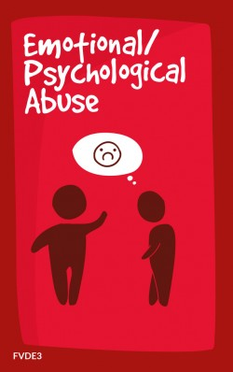
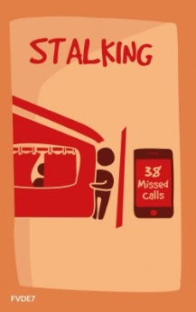

L2 Heading here
What is changing?
  Residential Tenancies Legislation Amendment (Family Violence) Bill 2018 is in Parliament
    Amending the Residential Tenancies Act (RTA) 1987 and the Residential Parks (Long-stay Tenants) Act 2006
Thanks to Legal Aid WA for allowing us to use Blurred Borders cards
Notes:
We’re removing tenancy law barriers for WA renters affected by family and domestic violence or FDV for short.
Got to be debated in the Upper House but could commence in April 2019.

Slide 3
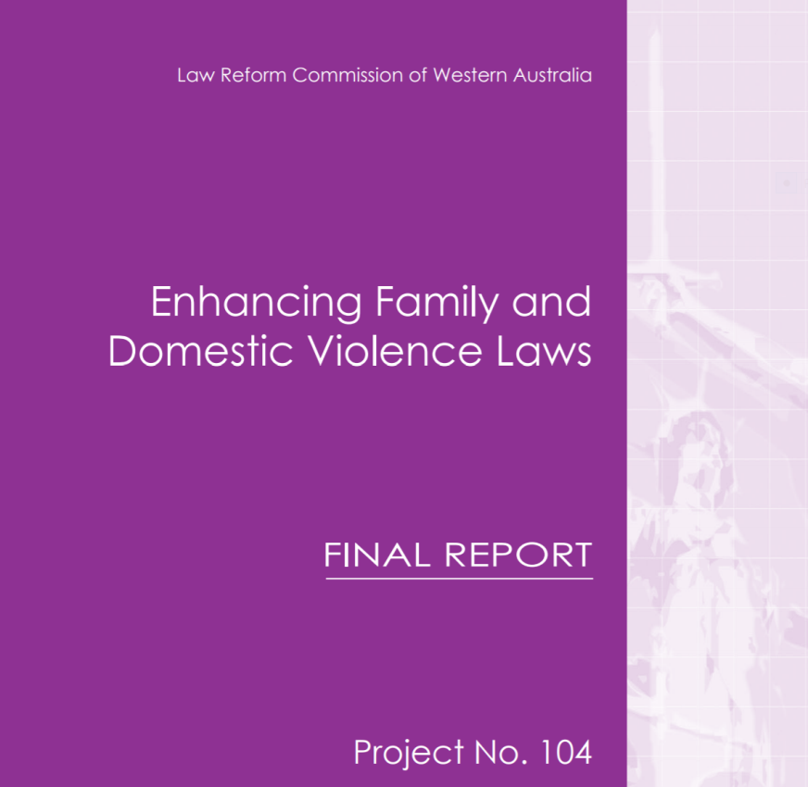

L2 Heading here
Where have these changes come from?
  The Law Reform Commission of Western Australia
Notes:
In 2013, the then Attorney General, the Hon Michael Mischin MLC, asked the Law Reform Commission of WA to investigate the benefits of having separate family and domestic violence orders and to have provisions for these contained in separate legislation.
The Law Reform Commission report recommended, amongst other things, that the then Department of Commerce undertake a review of the interaction between the Residential Tenancies Act 1987 and family violence orders to consider whether any reforms are necessary to better accommodate the parties’ circumstances where family violence occurs in a tenancy setting.
Western Australia is the only jurisdiction at the moment that does not have family violence related tenancy laws.

Slide 4
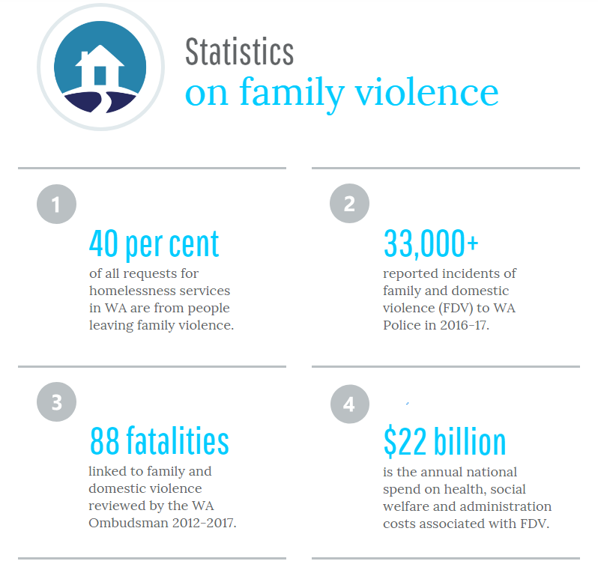
Notes:
Why is it so important that we implement these laws?
More than 40% of all requests for homelessness services in Western Australia are from people leaving family and domestic violence
In 2016-2017, this amounted to 10,868 requests; almost 30 per day.
In 2016, 29,800 Western Australians reported experiencing intimate partner violence.
In 2015-16 there were 34,118 reported offences for FDV related crimes in Western Australia.
In 2015-16, there were 27 domestic homicides in Western Australia.
The combined health, administration and social welfare costs nationally of FDV have been estimated to be $21.7 billion a year.
Tenants who are victims of FDV need to be able to terminate a tenancy agreement at short notice or they need certainty of excluding the perpetrator in order to be able to make a safe move away from a violent relationship.

Slide 5

L2 Heading here
New options for tenants affected by FDV
–Give 7 days notice to lessor and leave rental
–Apply to court to have perpetrator removed from tenancy agreement and remain in the home
Notes:
In a nutshell, tenants who have been a victim of family and domestic violence will be able to:
terminate their own interest in a tenancy agreement by giving a notice to the lessor, if they want or need to leave the rental
(outline evidence requirements, FVRO or prescribed form signed by a designated professional); or
apply to the court to have the perpetrator’s interest in the tenancy agreement terminated if they want to remain in the rental premises.

Slide 6



L2 Heading here
Other key changes
  –The Court will be able to assign liability for damages or unpaid rent to the perpetrator.
  –Tenants affected by FDV will be able to:
  change locks without permission; and
  make security upgrades at their own cost.
  –Restriction on listing tenants, who are victims of FDV, on tenancy databases.
Notes:
The Court will be able to assign liability for any damages or unpaid rent to the perpetrator of the violence – it doesn’t change how much you can claim.
A tenant who has been a victim of FDV will be able to change the locks without waiting for permission (but will have to supply the lessor with a copy of the key within seven days).
A tenant who has been a victim of FDV will be able to make prescribed security upgrades to the premises (at their own cost and premises must be restored at the end of the tenancy).
Restriction on listing tenants who have been a victim of FDV on a residential tenancy database.

Slide 7

L2 Heading here
Changes in detail
  –What is family violence? (Section 3 of the RTA)
  Family violence has the meaning given in the Restraining Orders Act 1997 section 5A(1).
  Family violence is a reference to:
  –violence, or a threat of violence, by a person towards a family member of the person; or
  –any other behaviour by the person that coerces or controls the family member or causes the member to be fearful.
Notes:
The proposed new laws use the same definition of family violence that is used in the Restraining Orders Act 1997 to ensure consistency of approach across courts and service providers.

Slide 8



L2 Heading here
Changes in detail – family is 2 persons:
  – who are, or were, married to, in a de facto relationship with, or related to, each other; or
  – one of whom is a child who ordinarily resides, or resided, regularly resides or stays, or resided or stayed, with the other person; or
  – one of whom is, or was, a child of whom the other person is a guardian; or
  – who have, or had, an intimate personal relationship, or other personal relationship, with each other.
Notes:
This is found in section 4 of the Restraining Orders Act 1997.

Slide 9



L2 Heading here
Continued … Who is a family member?
  –Other personal relationship means
    a personal relationship of a domestic nature in which the lives of the persons are, or were, interrelated and the actions of one person affects, or affected, the other person.
    – Related means
    a person is related to that person taking into consideration the cultural, social or religious backgrounds of the 2 persons; or
    related to the person’s spouse or former spouse or de facto partner or former de facto partner.
Notes:
This is found in section 4 of the Restraining Orders Act 1997.
These two terms link back to the definition of family relationship on the previous slide.
The important take away message is that family violence is to be considered in its broadest context in terms of relationships to include extended family members, elder abuse, child abuse, guardianship or carer relationships with the people they are responsible for caring for, and cultural understandings of family.

Slide 10

L2 Heading here
Changes in detail – family violence behaviour
  – Any of the following against the family member:
  Assault or sexual assault or sexually abusive behaviour
  Stalking or cyber stalking or repeated derogatory remarks
  Damaging or destroying the family member’s property
  Causing death or injury to the family member’s animal
  Denying financial autonomy or withholding money needed to meet reasonable living expenses of dependent family member or their child
  Preventing social connections or kidnapping or depriving liberty
  Distributing, publishing or threatening to distribute or publish intimate personal images
  Exposing children to any of these behaviours
Notes:
This is found in section 5A of the Restraining Orders Act 1997.
This is not an exhaustive list.
Note stalking – it is important to note that the legislation does not require the perpetrator to be a tenant. If a tenant is being stalked by someone out of the home and needs to move to be safe, they can access these provisions.

Slide 11

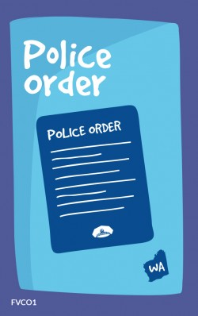
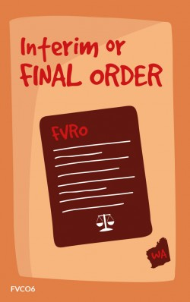
L2 Heading here
Changes in detail – victim wants to leave
  – Section 71AB
  Tenant gives lessor prescribed notice of termination
  Notice must be accompanied by one of the following:
  a DVO;
  a family court injunction or application for a family court injunction;
  a copy of a prosecution notice or indictment containing a charge relating to violence against the tenant or a court record of a conviction of a charge; or
  a report of family violence, in a form approved by the Commissioner for Consumer Protection.
Notes:
DVO is defined in the Amendment Bill as a DVO per the definition in section 4(1) of the Domestic Violence Orders (National Recognition) Act 2017. In section 4(1) a DVO means a local or interstate DVO or a foreign order. A local DVO is family violence restraining order or a police order. An interstate DVO is an order made in another state or territory that is substantially like a local DVO.

Slide 12

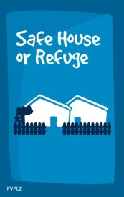
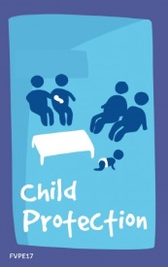
L2 Heading here
Report of family violence
  – Who can sign?
  Doctor
  Psychologist
  Social worker
  Police officer
  Manager of a women’s refuge
  Prescribed person(s) / class of
Notes:
The regulations are currently being drafted. It is likely the following will be prescribed as persons who can sign the report:
Child Protection workers; and
Family Support workers funded under the Child Protection Act (includes Aboriginal Family Support workers).

Slide 13

L2 Heading here
Changes in detail – after victim gives notice
  – Section 71AB and 71AD
    Victim tenant’s liability ceases at the end of the notice period (default seven days)
    Lessor must give a copy of the termination notice (but not the attached documents) to any co-tenants
    Co-tenants have seven days to decide whether to remain in the tenancy or to leave
    If leaving, co-tenants give 21 days’ notice
Notes:
Co-tenants can terminate their interest in the tenancy agreement under section 71AD even if it is a fixed term tenancy agreement.
The reason for this is that if the remaining co-tenants are unable to afford to pay the rent, there is no point in setting the parties up to fail by requiring them to be locked into the balance of a fixed term agreement.

Slide 14



L2 Heading here
Victim wants to remain in the tenancy
  – Section 71AE
    Tenant applies to court to have perpetrator’s interest in the tenancy agreement terminated
    – Court must be satisfied that:
    a family violence order is in force against the perpetrator; or
    the perpetrator has, during the period of the tenancy, committed family violence against the victim tenant or their dependent.
    Tenant applies using Magistrate Court Form 12
    – The lessor and any co-tenants must be named as respondents on the application.
Notes:
Co-tenants can terminate their interest in the tenancy agreement under section 71AD even if it is a fixed term tenancy agreement.
The reason for this is that if the remaining co-tenants are unable to afford to pay the rent, there is no point in setting the parties up to fail by requiring them to be locked into the balance of a fixed term agreement.

Slide 15
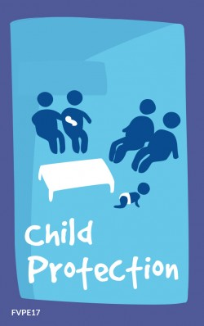
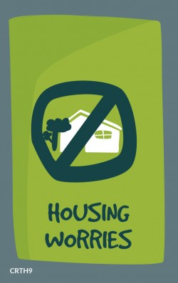

L2 Heading here
Factors the court must take into account
  – Section 71AE
  best interests of any child ordinarily resident at the premises;
  best interests of the protected tenant, including, if the premises under the residential tenancy agreement are social housing premises, the ability of the tenant to meet any eligibility criteria for those premises;
  effect the order might have on the lessor and any tenants other than the protected tenant;
  effect the order might have on any pets kept on the premises;
  the fact that perpetrators of family violence might seek to misuse the protections offered to tenants and lessors under this Act to further their violence and the need to prevent that misuse.
    – xx
Notes:
This is not an exhaustive list and the court may take into account any relevant information
The best interest of any child ordinarily resident at the premises is to be the paramount consideration.

Slide 16

L2 Heading here
Assigning liability for damages & debt
  – Section 17B
  Ordinarily, co-tenants are jointly and severally liable for damage and debt arising out of the tenancy agreement
  Either a departing tenant or a remaining tenant can apply to the court for an order to determine each tenant’s liability for damages and any debt arising out of the tenancy agreement
  Use a Form 12 to apply – all co-tenants and the lessor should be listed as respondents to the action
  The Court can order:
    who is to pay what to whom; and
    disposal of part or all of the bond – includes releasing part of the bond to victim tenant if they’re leaving and are held not to owe any debt to lessor.
Notes:
Debt arising out of the tenancy agreement must be linked to the tenancy agreement itself – for example unpaid rent.
Debts for utilities such as water and gas can only be assigned under this provision if the accounts are in the name of the lessor.

Slide 17

L2 Heading here
Changing locks
  – Tenant is allowed to change locks without first seeking the permission of the lessor either:
  after the perpetrator’s interest in the tenancy agreement has been terminated; or
  if it is necessary to prevent family violence that the tenant suspects on reasonable grounds is likely to be committed against the tenant or their dependent.
– Tenant must provide lessor with a copy of key within 7 days
    – Lessor is prohibited from giving a copy of a key to anyone the tenant has instructed them in writing not to give the key to
Notes:
Schemes are available that may be able to help fund lock changes (Safe at Home or free with Dept of Housing is you prove FDV)
Social housing providers may not need a copy of the key – ask

Slide 18
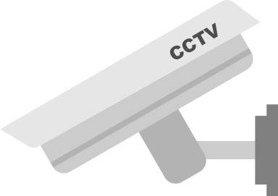

L2 Heading here
Security upgrades
  – Tenant allowed to make prescribed security upgrades to premises without lessor’s permission:
  after perpetrator’s interest in tenancy agreement is terminated; or
  if it is necessary to prevent family violence that the tenant suspects on reasonable grounds is likely to be committed against the tenant or their dependent.
– Cost of repairs is borne by the tenant
– Alterations must be made by a qualified tradesperson
– Must comply with strata by-laws, and have regard to age and character of the house
– Tenant must restore premises at end of tenancy if lessor asks
Notes:
Types of security upgrades that will be allowed will be prescribed in the Regulations.
They are likely to be:
security alarm;
CCTV cameras;
window locks, screens and/or shutters;
security screens on the doors (door locks can be changed without permission of the lessor under another amendment in the Amendment Bill so this doesn’t need to be prescribed in this list);
exterior lights;
changes to external gate locks (excluding gates for common areas in strata properties or residential parks); and
pruning of shrubs and trees abutting the agreed premises
Tenant will need to tell landlord of their intentions and provide a copy of the invoice.

Slide 19
L2 Heading here
Tenancy databases
  – Section 82J of the Act currently allows a tenant to apply to the court to have a tenancy database listing about them wholly or partially removed, amended in a stated way or not listed in a database if the listing is unjust in the circumstances.
  The Amendment Bill makes clear it is unjust to list a person on a tenancy database if the reason for the listing arises out of them being subjected or exposed to family violence.
  Application to the court would be made on a Form 12.

Slide 20

Want more information?
  – We have a dedicated web page
  www.dmirs.wa.gov.au/familyviolence
  –Connect, like, follow or share on social
    Consumer Protection Western Australia
    LinkedIn
    Facebook
    Instagram
    Twitter
    YouTube
Notes:
Follow the Bill’s progress and keep an eye on communication materials we develop by saving our web page to your favourites.
We’re also on all the main social media channels – search Consumer Protection Western Australia or the hashtag:#stopfamilyviolence

