Slide 1
Fathering and attachment
Kevin Hanavan
Family Law Pathways Conference
31 May 2018

Slide 2
Kramer vs Kramer
Kramer Vs Kramer French toast First scene
https://www.youtube.com/watch?v=gVUZma7L8TU

Slide 3
Kramer vs Kramer
Kramer Vs Kramer French toast Second scene
https://www.youtube.com/watch?v=d5bv02MopFU

Slide 4
What we will cover today
Contemporary controversy about father involvement and attachment in the family law sector
What can the history of attachment research and theory tells us about father involvement and attachment?
Attempts to reconcile the differences and to further a more integrated approach

Slide 5
Pooh and Piglet - Looking for a Woozle

Slide 6
2011 Family Court Review
A special edition on attachment, edited by Prof Jen McIntosh, interviews with:
Alan Sroufe
Allan Schore
Daniel Siegel
Carol George and Judith Solomon
Richard Bowlby
Everett Waters

Slide 7
2012 response
Pamela Ludolph – The Special Edition on Attachment: A wasted Overreaching Theaory and Data
Michael Lamb – A Wasted Opportunity to Engage with the Literature of Attachment Research for Family Court Professionals
Richard Warshak - Social science and parenting plans for young children: A consensus report.

Slide 8
What were to contentious issues?
Monotropy – primary attachment figure
Maternal deprivation
The role of the fathers:

Slide 9
Monotropy
The idea that infants form attachment relationships with a single caregiver before all other important relationships.
“ … (monotropy) is a concept proposed but later abandoned by John Bowlby (1969)”
Richard Warshak (2012)

Slide 10
Michael Lamb
“the reader could be forgiven for thinking that the issues discussed in McIntosh’s interviews were novel topics that had escaped the attention of attachment researchers and Family Court professionals until now”

Slide 11
The Bowlby – Ainsworth tradition
What is the Bowlby-Ainsworth tradition?
What does the history of research and theory from Bowlby and Ainsworth to the present tell us about the children's attachment to their fathers?

Slide 12
What I hope to show
Although much research was centred on children’s attachment to mothers awareness of fathers and children’s attachment to fathers has been present throughout the history of attachment research
Research and theorising about father’s has occurred within the Bowlby-Ainsworth tradition

Slide 13
Maternal deprivation
Maternal Health and Maternal Care - published for the World Health Organisation 1951
Separation from maternal attachment figure causes significant despair and damage to the emotional wellbeing of children

Slide 14
Maternal Deprivation critiqued
James Robertson – hospital studies
Michael Rutter – privation rather than maternal deprivation, causes harm
Mary Ainsworth – parental deprivation

Slide 15
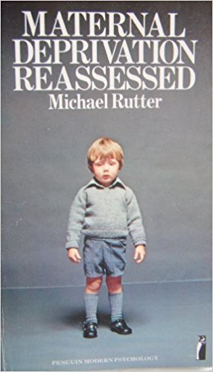

Slide 16
Michael Rutter
Maternal deprivation Reassessed (1972)
“The father, the mother, brother, sister friends, school teachers and others all affect development, but their influence and importance differ for different aspects of development. A less exclusive focus on the mother is required. Children also have fathers!”

Slide 17
Mary Ainsworth
1962 WHO report
“Although in the early months of life, it is the mother who almost invariably interacts with the child … the role of the father is acknowledged to be significant … paternal deprivation has received scant attention”
“the term ‘parental deprivation’ would have been more accurate, for the child has been deprived of interaction with a father-figure as well as a mother-figure”

Slide 18
Bowlby’s early theory of attachment
Did not consider fathers specifically
refers to mothers or ‘mothering figures’
Bowlby’s primary attachment to his nursemaid, Minnie

Slide 19
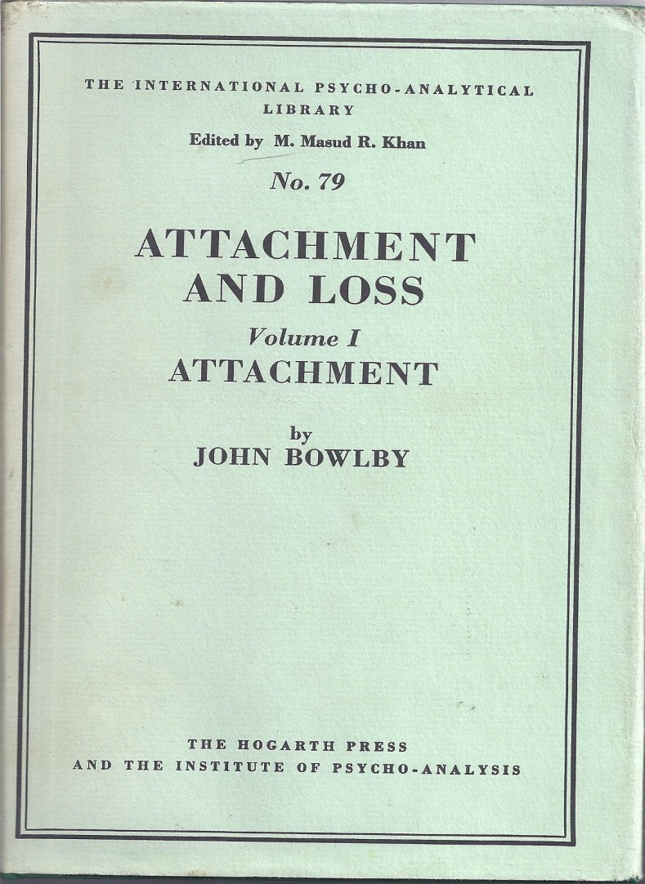
Bowlby’s early theory of attachment
Did not consider fathers specifically
refers to mothers or ‘mothering figures’
Bowlby’s primary attachment to his nursemaid, Minnie

Slide 20
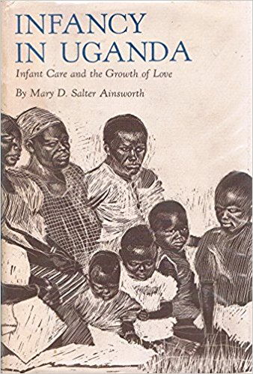
Ainsworth’s initial research
“Our stereotype of the infant developing an attachment to the mother and the mother alone during the first year is not borne out by these observations, despite evidence that when the chips are down the attachment to the mother usually seems to be the focal one”.

Slide 21
Schaffer & Emerson 1964
Rudolph Schaffer and Penny Emerson – colleagues of Bowlby:
Observed 60 infants over 18 months in Scottish families in their homes
Children formed attachments to both parents by 18 months and 10-15% exclusively to the father but not the mother

Slide 22
Bowlby responds - 1969
retained the notion of monotropy, but wrote:
“the infant’s tendency to seek out a principal attachment figure in preference to a number of secondary figures …children seek playmates, but will seek attachment figures when they are tired, hungary, ill, alarmed or uncertain”.

Slide 23
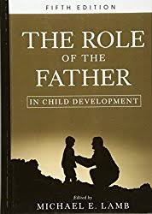
Michael Lamb
1976 – similar level of contact seeking behaviour demonstrated by infants to mothers and fathers
But
When a stranger joined the room the behaviour was directed towards the mother

Slide 24
Michael Lamb
1977 – conducted home observations of infants up to 24 months:
6 -12 months, infants approached both parents and fathers instigated more play while mothers demonstrated more nurturing
1978 – used the Strange Situation Procedure and found infants had attachments to mothers and fathers at 12 months that were not necessarily the same

Slide 25
Mary Main
Doctoral student of Mary Ainsworth in Baltimore
Moved to California to carry on attachment studies
Replicated Lamb’s findings – children can have secure attachment to both parents, one parent or neither parent and these attachment relationships are independent

Slide 26
Bowlby responded - 1982
In a revised edition of Attachment and Loss , Bowlby writes:
“a young child’s experience of an encouraging, supportive, and cooperative mother, and a little later father, gives him a sense of worth, a belief in the helpfulness of others, and a favourable model on which to build future relationships”

Slide 27
Bowlby’s final word - 1988
In A Secure Base, Bowlby writes:
“… by providing an attachment figure for his child, a father may be filling a role closely resembling that filled by a mother; though in most cultures fathers fill that role much less frequently than do mothers, at least when the children are still young”
“In most families with young children the father’s role is a different one. He is more likely to engage in physically active and novel play than the mother and, especially of boys, to become the child’s preferred play companion”

Slide 28
Grossman & Grossman
Klaus Grossman & Karin Grossman – good friends and colleagues of Mary Ainsworth and Mary Main:
Conducted a longitudinal study in Berlin – they looked at play and exploration in relation to attachment, beyond that recognised by Bowlby

Slide 29
Grossman & Grossman
1992
“Security attachment involves tender loving care, comfort and consolation and external help with emotion regulation”
however …
“this security does not suffice to create psychological security in children who must explore to gain knowledge and skills … it needs to be supplanted by the equally necessary security of exploration, based on sensitive support from mother and father”

Slide 30
Bretherton, Lambert, & Golby 2005
Built on Grossman and Grossman and found infant’s preferences to different attachment figures is dependent on subtle specifics of the situation

Slide 31
Gender vs Gender Roles
Grossman, Grossman, Kindler & Zimmermann (2008)
Found that the dichotomy between safety and security and exploration and play is not related to gender per se, but to gender roles
Either or both parents can provide security and nurturance as well as fostering play and exploration

Slide 32
Sir Richard Bowlby
2010 interview:
“I remember asking my father about the role of fathers in attachment theory, but he didn’t have a well thought out opinion and finished the conversation by saying ‘well a child doesn’t need two mothers’”
“I suspect his intense focus on mothers has biased researchers and distorted cultural values”

Slide 33
Sir Richard Bowlby model of attachment
Influenced and endorsed by Klaus and Karin Grossman
“Being a ‘primary attachment figure’ would change the importance we place on fathers … it would allow us to re-evaluate the importance of a father’s role and to recognise that his significance in his child’s history is equal to that of a mother’s”

Slide 34
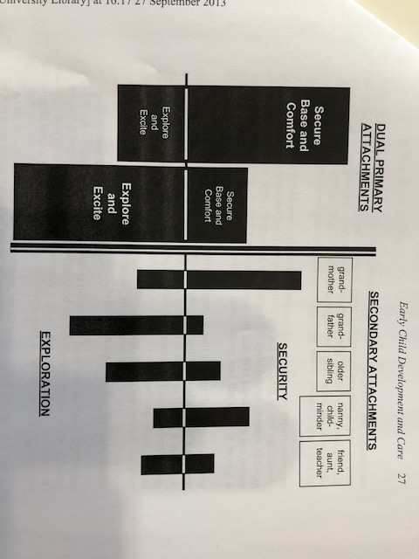

Slide 35
Sir Richard Bowlby - 2010
“this is a bit controversial to say that children may have two primary attachment figures, but if dads matter, then they matter”

Slide 36
Going off on a tangent
Testosterone research
Testosterone drops through pregnancy and then dramatically immediately after the birth
Involved fathering is associated with lower testosterone
Lower testosterone is associated with greater empathy, responsiveness to infant cries

Slide 37
Bowlby – Ainsworth tradition
Most significant research in attachment has been carried out by colleagues and associates of John Bowlby or Mary Ainsworth. Richard Bowlby is the son of John Bowlby and is the patron of the Bowlby Center in London
All the research reviewed here is in the Bowlby – Ainsworth tradition

Slide 38
Can this history help?
2013 AFCC Think Tank
32 invited guests, researchers, theorists, lawyers and judicial officers.
All our main players were invited, Jenn McIntosh, Richard Warshak, Michael Lamb, Marsha Kline Pruett
Chief Justice Diana Bryant invited but unable to attend

Slide 39
What did they conclude?
Shared parenting is different to divided parenting time
Parenting plans are best when they are built around “family functionality” rather than “perceived parental fairness”
“it is more difficult for men than women to stay committed to parenting after separation but it is important for the family that they do so when they are motivated to be loving, engaged parents”

Slide 40
McIntosh, Pruett & Kelly 2014
“… a synthesis of attachment and parental involvement is both possible and empirically supported”
“the young child needs early, organised caregiving from at least one, and most advantageously more than one available caregiver. An optimal goal is “a triadic secure base” constituted by both parents and the child”

Slide 41
McIntosh, Pruett & Kelly 2014
They suggest:
“high frequency overnight schedules can be disruptive to children’s attachment”
But…
“cautions against any overnight time between infant and non-resident parent are not supported by the literature”

Slide 42
McIntosh, Pruett & Kelly 2014
“We should not reduce developmental needs to either-or scenarios”
“How much time is needed to ensure separated parents each have a positive relationship and are able to consolidate a foundation for life”
“Attachment and parent involvement need to become ‘nested concepts’”

Slide 43
What about the neuroscience
“I know there is neurobiological research that demonstrates (gender) differences. I just cannot get myself to take those findings seriously because of my own experience as a father, because of my own experience of my parents, because of my experience as a therapist. Both men and women have deep potentials for caring for infants”
Dan Siegel 2011

Slide 44
Anthropology
Fathering and father involvement is changing rapidly and this is occurring across the globe
Gender in a gendered world
Parental conflict and family violence
Father involvement and father’s responsibility - The Fathering Project vs The Red Pill

Slide 45
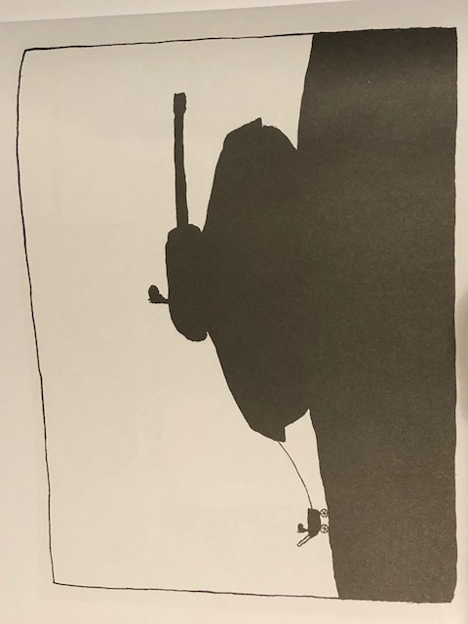
Parental conflict

Slide 46
Daddy’s Home 2

Slide 47
Thank You
Kevin.hanavan@justice.wa.gov.au

